Slide 1
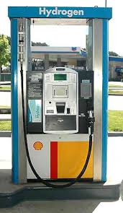
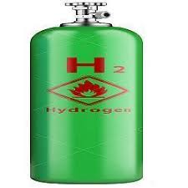
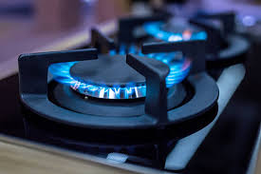
HYDROGEN –FUEL
Nagpur jio state office –Fidvi tower
Green and renewable energy
gas
Hydrogen Fueling Station Like LPG
I always intend to work on this project as energy is necessity of life ,crude oil prices increasing consistently and we cant rely on it for ever, so Hydrogen Generation to fuel our future energy need is our necessity

Slide 2
Personal information
I am Amol Bakane – 0091-8551910269,
I am Electrical engineer from Maharashtra INDIA and I have done M tech from London university – I have 10 years of working experience in Electrical Projects – Oil and gas industry
Amol.Bakane@gmail.com
I always intend to work on this project as energy is necessity of life ,crude oil prices increasing consistently and we cant rely on it for ever, so Hydrogen Generation to fuel our future energy need is our necessity -------
I am Amol Bakane (serving reliance jio-info-com as senior executive in Electrical dept. )-0091-8551910269
amol.bakane@gmail.com / amol.bakane@zmail.ril.com- INDIA (Nagpur) I am Electrical engineer and I have done M tech from London university

Slide 3
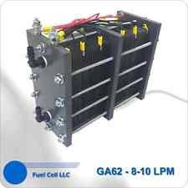
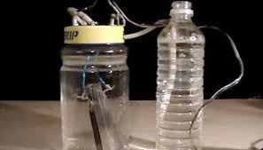
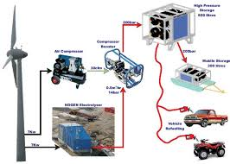
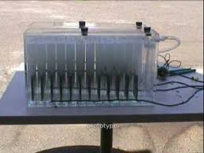
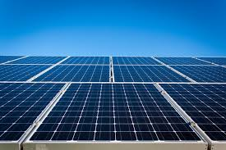
H2O splitting by Electrolysis process
Solar panel can be used to power hydrolysis process

Slide 4
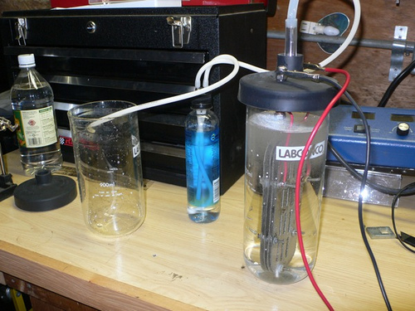
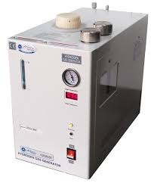
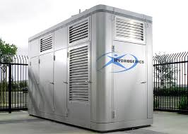
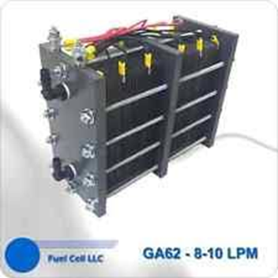
Chemical reaction –Hydrolyses process or electrolysis process
Commercial Generator
Notes:
H2O is chemical formulae for water can be split apart by hydrolysis process, H2 get attracted toward negative electrode and O toward positive electrode ,electrodes are steel or graphite material ,and can contribute to Hydrolysis process

Slide 5
Commercial Hydrogen Generator POWERD BY SOLAR PANEL
Commercial hydrogen generator available in market
Solar power can be used to power hydrolysis process

Slide 6
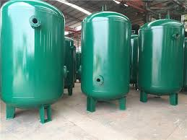
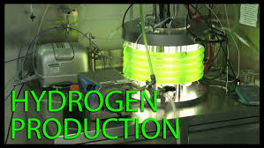
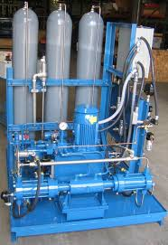
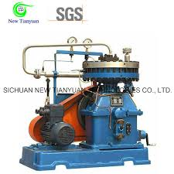
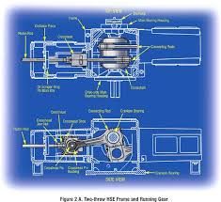
Hydrogen compression process
Hydrogen storage tank
Hydrogen Compressors

Slide 7
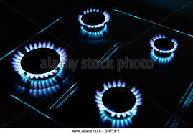

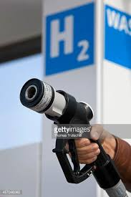
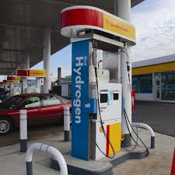
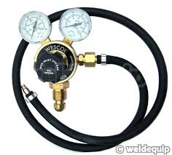
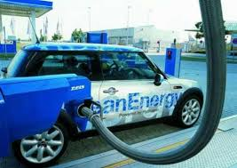
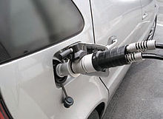
Hydrogen fueling station
Gas for Cooking

Slide 8
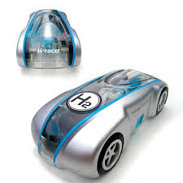
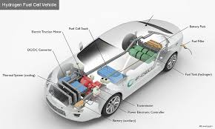
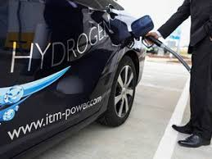
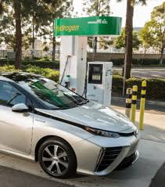
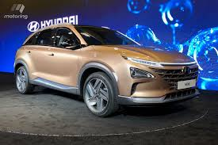
Hydrogen car
We can use Solar panel to generate Electricity and that energy can be utilized to generate hydrogen ,(a future fuel) (there is enough sun radiation to harvest substantial energy to meet energy need and storage can be done in the form of hydrogen, The only need is to get in to this business , company's like BMW using this
LPG car can also run on it ,
no alternation required in car.

Slide 9
Expecting quicker response
Todays date 08/05/2018
Expecting investment of substantial fund to implement this business on Major scale
Expecting Hydrogen stations Powered by Your Company
Expecting trust AND support from Your board of directors with deep commitment and interest
Cost for Hydrogen production will be 40 RS per KG ,which is more economical than petrol
This project has been implemented in many countries ,then why not us!
Waiting for Your response !
Amol Bakane contact no 0091-8551910269 amol.bakane@zmail.ril.com and amol.Bakane@gmail.com- Personal ID And Country –India

Slide 10
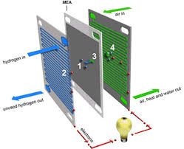
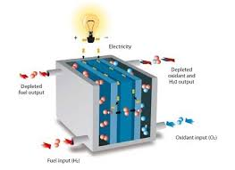
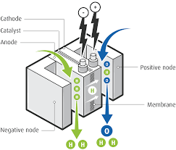
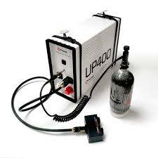
Additional provision– if we need electrical energy from hydrogen ,use this
Hydrogen Fuel Cell
, Efficient and Evolved technology on which future car will run and the fuel is abundant in nature , the need is to harvest It and to evolve efficient technology to harvest Hydrogen ,
Notes:
Fuel cell convert Hydrogen gas in to electricity

Slide 11
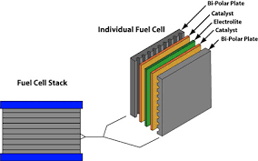
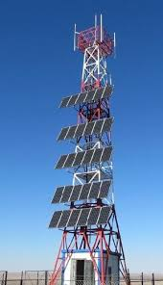
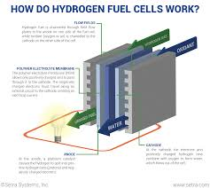

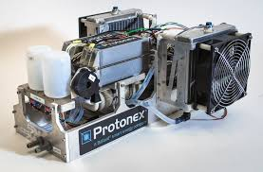

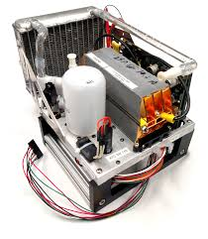
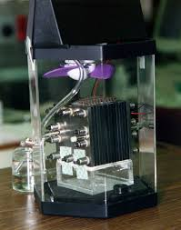
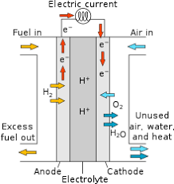
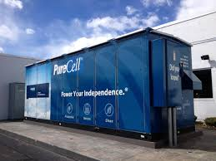
To power Telecom tower using Hydrogen and fuel cell
Fuel cell model
Notes:
Hydrogen can be utilized to convert it in to electricity using fuel cell , commercial fuel cell generators are available in market ,

