Slide 1
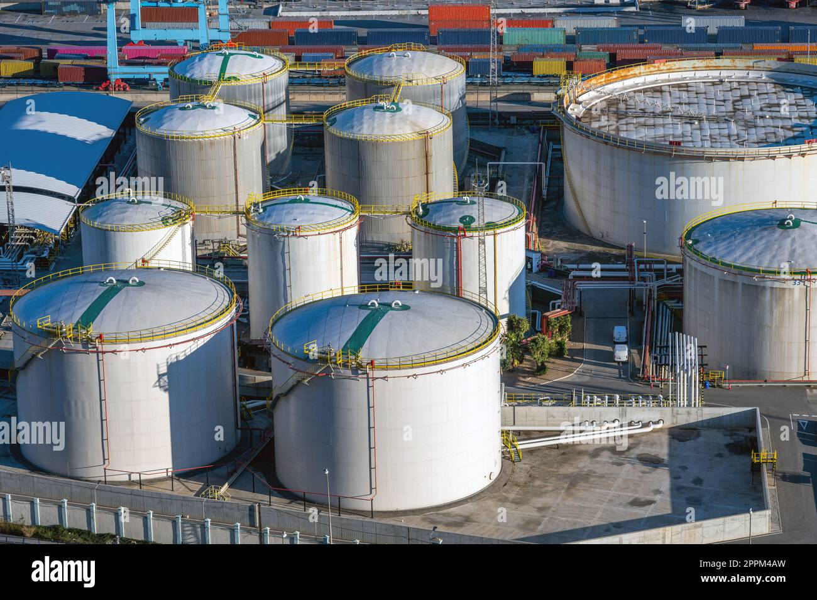
ENERGY STORAGE IN FORM OF HYDROGEN AND USED FOR HYDROGEN GAS TURBINE

Slide 2
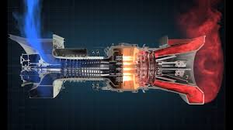
HYDROGEN AS A FUEL
GAS TURBINE

Slide 3
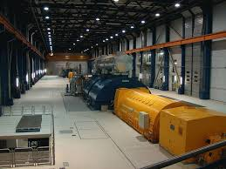
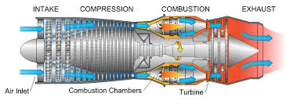
TURBINE AND GENERATOLR

Slide 4
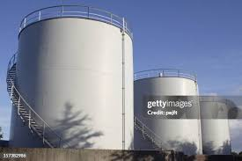
HYDROGEN AS FUEL
HYDROGEN GAS STORAGE

Slide 5
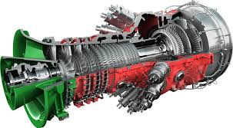
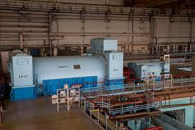
GAS TURBINE DRIVES GENERATOR
HYDROGEN GAS TURBINE

Slide 6
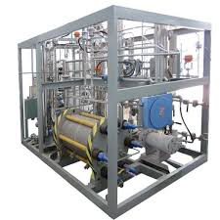
Hydrogen Generator is used to store hydrogen gas
HHO Generator

