Slide 1
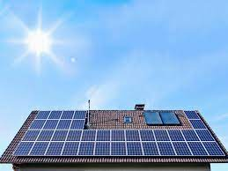
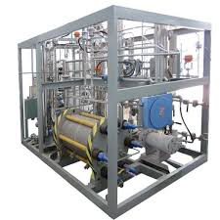
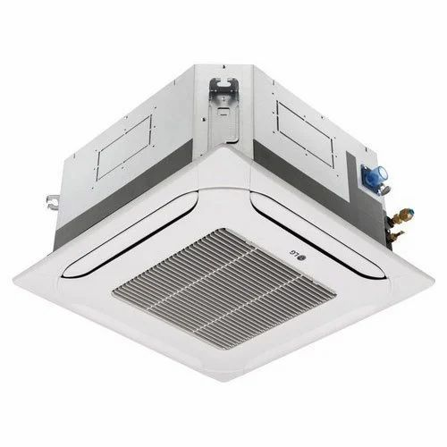
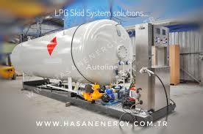
ENERGY STORAGE IN FORM OF HYDROGEN AND USED FOR AIR CONDITIONING
ENERGY STORAGE
AIR CONDITIONING
F
Notes:
AIR CONDITION INDOOR UNIT ONLY REQUIRED ,OUTDDOR UNIT NOT REQUIRED

Slide 2
Freon And Hydrogen gas can be compressed using solar energy
Freon gas in Tank 1
Hydrogen gas in tank 2

Slide 3
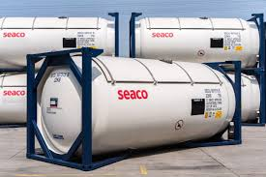
PRESSURED HYDROGEN GAS USED FOR AIR CONDITIONING AND GAS GEASER
HYDROGEN GENERATOR
STORAGE TANK
Notes:
GAS expansion property to create thermal effect, when you release compressed hydrogen in Expansion tube of Air conditioners ,then it will create cooling iffect like air conditioning

Slide 4
Energy storage in {Hydrogen gas} Tank
Use of GAS expansion property to create thermal effect,Like air conditioning
When you release compressed hydrogen in Expansion tube of Air conditioners ,then it will create cooling iffect like air conditioning
Hydrogen generator used to generate hydrogen and storage can be done in Tanks ,Energy from solar panel can be used to produce hydrogen

Slide 5
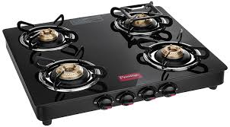
GAS can be used for cooking

Slide 6
Hydrogen Generator is used to store hydrogen gas
HHO Generator

Slide 7
Stored GAS can also be used for cooking ,
Stored gas can also be used for gas geaser
Stored gas can also be used for Air conditioning , here gas expansion property of gas can be utelized to create cooling effect
Energy storage is the advantage and project implimentation can be done on Roof top or many industrial application

Slide 8
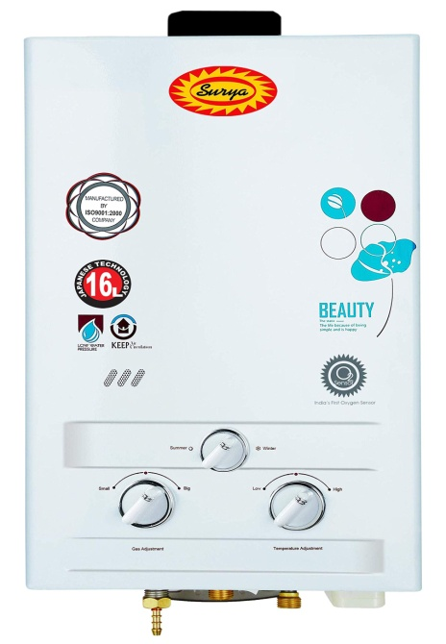
PRESSURED HYDROGEN GAS USED FOR GAS GEASER
ROOFTOP SOLAR
GACS
GEASER
Notes:
GAS expansion property to create thermal effect, when you release compressed hydrogen in Expansion tube of Air conditioners ,then it will create cooling iffect like air conditioning

Slide 9
Stored gas with three applications
HYDROGEN GAS
FREON GAS

Slide 10
Energy storage in form of hydrogen and freon gas
Gas compresser is used which will run on solar energy
compressed gas can be used as stored energy
when we use tanks to store energy
we store energy in compressed gas form
thus we can store energy

Slide 11
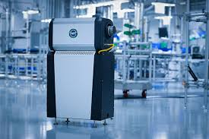
Fuel cell to generate energy from stored hydrogen gas

Slide 12
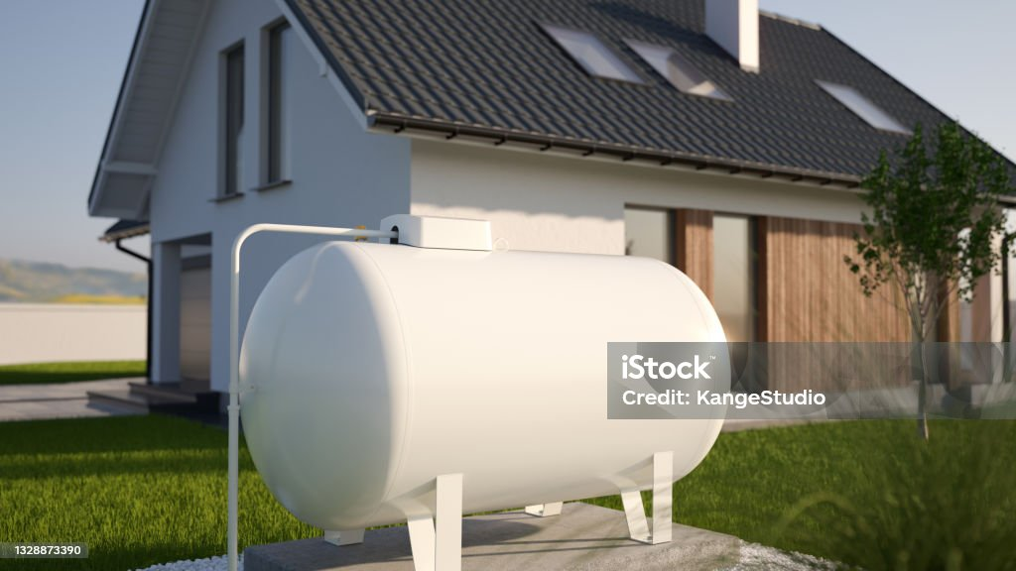
Freon gas compressed for air conditioning

